Slide 1

Segmentation and Clustering Neighbourhoods in Chennai
SURAJ ESWARAN

Slide 2
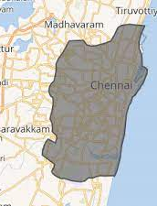
introduction
Chennai, Capital of Tamil Nadu
Located on the Coromandel Coast of the Bay of Bengal.
Largest Exporter of services for IT and BPO
Detroit of India

Slide 3
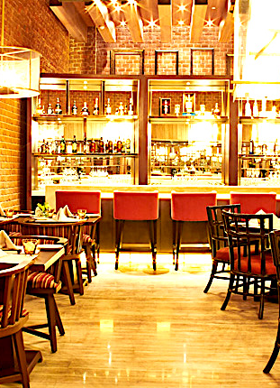
PROBLEM formulation
The main objectives of the project are:
Analyse various restaurants in Chennai
Find the preferred restaurant for the investor to start in Chennai.

Slide 4
Extraction of Data
Web Scraping: Wikipedia for obtaining information about Chennai Areas.
Requests lets you send HTTP/1.1 requests
BeautifulSoup is a library which is used for parsing HTML and XML documents.

Slide 5
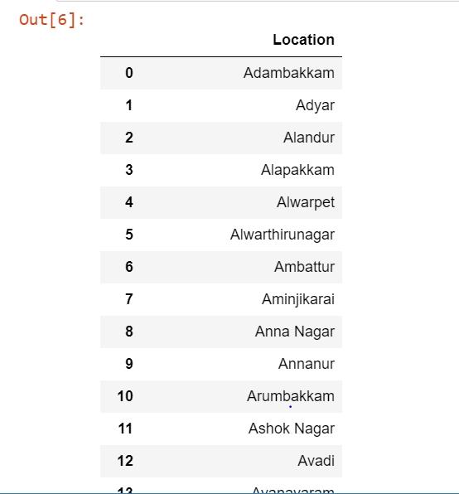
Our DATASET

Slide 6
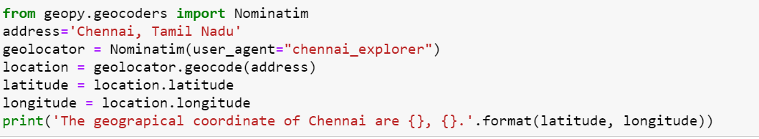
Data PREPROCESSING
Link each area with their latitude, longitude, and altitude.
Using Nominatim Geocoding service
Latitude= 13.0836939,Longitude=80.270186

Slide 7
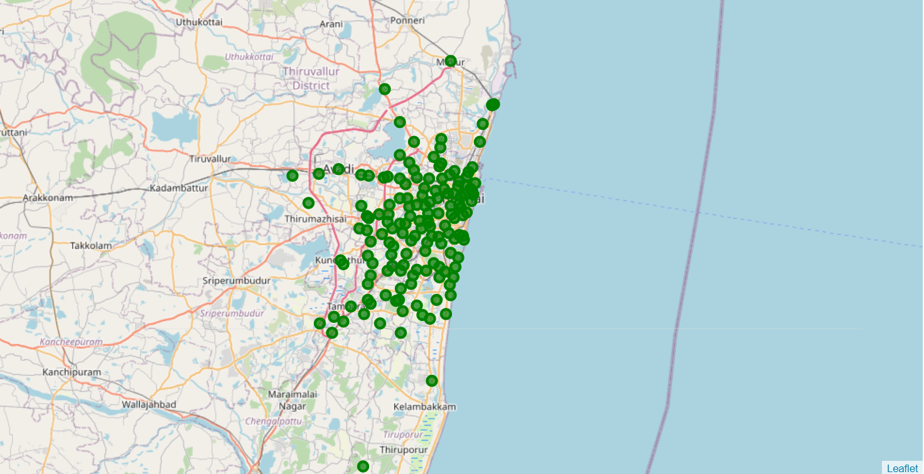
MAP OF CHENNAI WITH AREAS BEING MARKED

Slide 8
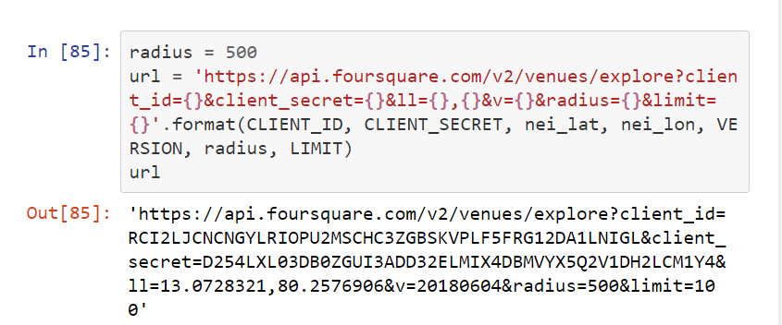
Data analysis
FourSquare API : Retrieving the locations and look for important venues around the location.
Helps us to find the top 100 venues within the radius of 500 meters.

Slide 9
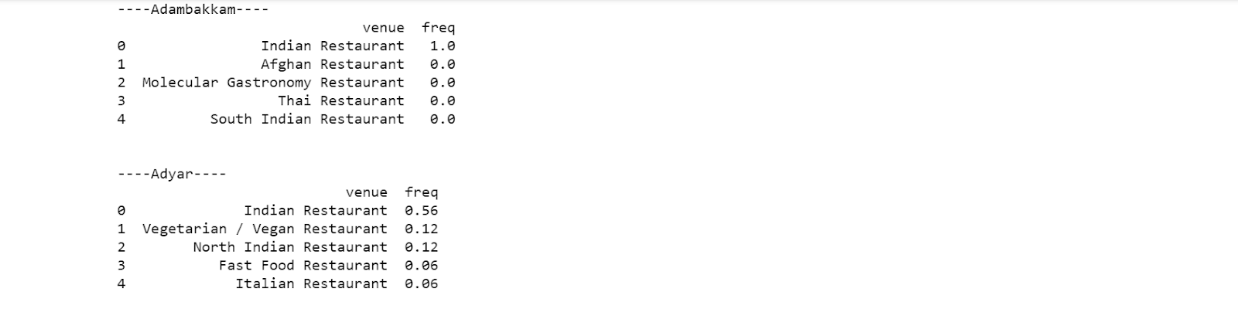
Top 5 common VENUES
Grouped the neighbourhood by taking the mean of frequency of number of occurrences
Ranked each neighbourhood with top 5 most common kinds of restaurant.

Slide 10
DATA CLUSTERING
Using K-Means Clustering
Best K value was found out to be 15
Given: Input K with a set of points, place with centroids repeat until we find convergence
Used Silhouette Analysis to show how close each point is in the cluster

Slide 11
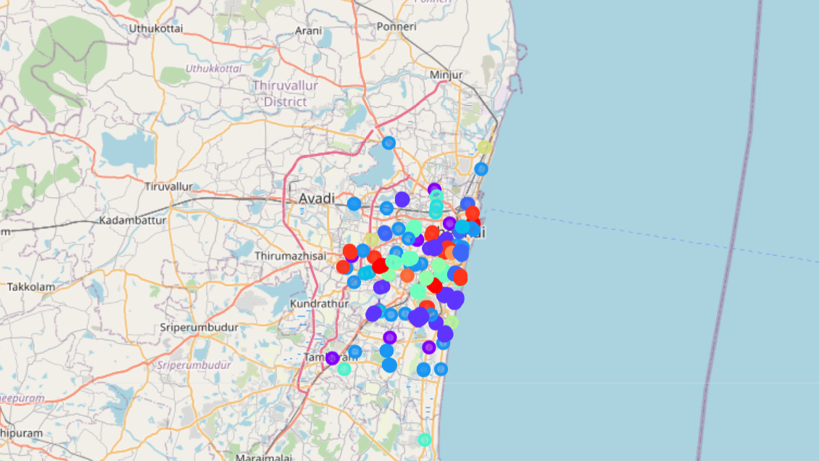

Slide 12
Result and discussion
We can construct the analogy in three ways:
If we want to start a restaurant by not keeping cuisine in mind, it is better to go for the least common restaurant so that it would be different to the customers and also provide a new trend in that area. In this case, We can find out that most of the clusters have New American Restaurant to be least, so it can be a trendsetter in a few areas like Alwarpet and Adyar.
If we want to start a restaurant by keeping cuisine in mind, then it is better to go for that area which has the least common restaurant based on that cuisine so that it would be a change to the customers. For example, if you are franchise and looking for which area to start the restaurant, it is better to look over those areas which are least common for that cuisine.
If we want to start a restaurant by keeping cuisine in mind, then they can find out the areas which have second and third common restaurants based on that restaurant because there can be cuisine-based restaurants which might not be successful, so this can be a game changer.

Slide 13
Conclusion
Used a list of areas of Chennai and its neighborhoods with a variety of restaurants
With the help of K-Means Clustering, neighborhoods are categorized with respect to top 10 common spots
Our future work will have more features on that type of restaurant.

Slide 14

THANK YOU

